Slide 1


THE NEW NORMAL -- VACCINATIONS & REOPENING
Shenal Devinda Bandara Rajaguru | Tan Shu Hua, Samantha | Teresa Zhang Han Yu |
Toh Yi Cheng | Venkataraman Sidhaarth

Slide 2
Agenda
Introduction
Relational Database Design
Implementation of methods
Comparison of Databases
Recommendations
Conclusion
01
02
03
04
05
06

Slide 3
COVID-19
a deadly global pandemic.
Introduction
Relational Database Design
Implementation of methods
Comparison of Databases
Recommendations
Conclusion

Slide 4
Introduction
Relational Database Design
Implementation of methods
Comparison of Databases
Recommendations
Conclusion
Many companies as well as governments today base many of their strategies and decision making entirely off insights driven from data
DATA
Data on the pandemic is pivotal to an entity’s survival and progress

Slide 5
WHY?
Why is too much data a problem?
Introduction
Relational Database Design
Implementation of methods
Comparison of Databases
Recommendations
Conclusion

Slide 6
Why is too much data
a problem?
Introduction
Relational Database Design
Implementation of methods
Comparison of Databases
Recommendations
Conclusion
02
01
02
02
Hard to manage
When managed wrongly, misinformation and disinformation can be detrimental to society

Slide 7
Importance of Data
Management
Introduction
Relational Database Design
Implementation of methods
Comparison of Databases
Recommendations
Conclusion
01
02
02
Efficiency of deriving the result from the data
Accuracy of the data

Slide 8
Introduction
Relational Database Design
Implementation of methods
Comparison of Databases
Recommendations
Conclusion

Slide 9
Database.
A collection of organised information that need to be easily accessed, managed and updated.
Introduction
Relational Database Design
Implementation of methods
Comparison of Databases
Recommendations
Conclusion

Slide 10
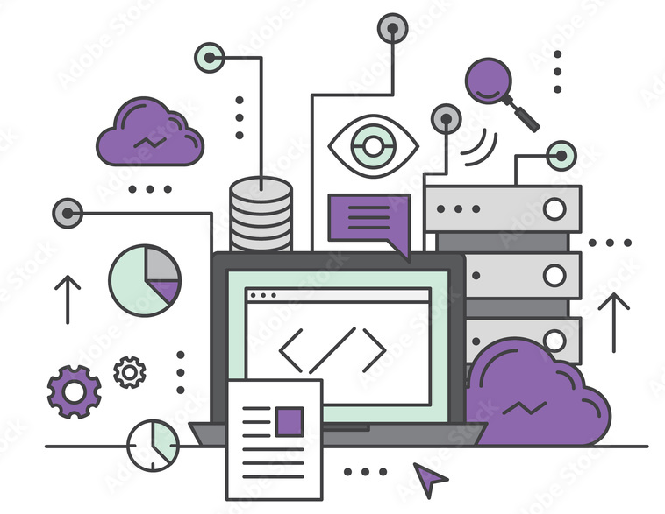
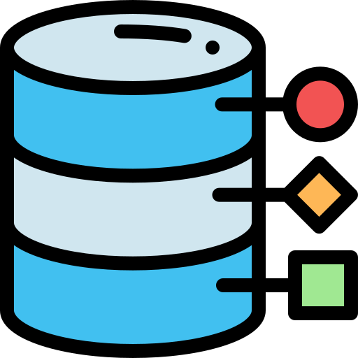


Importance of Data
Management
Introduction
Relational Database Design
Implementation of methods
Comparison of Databases
Recommendations
Conclusion
SQL
NoSQL

Slide 11
Relational Database Design.
Introduction
Relational Database Design
Implementation of methods
Comparison of Databases
Recommendations
Conclusion

Slide 12
Assumptions for Relational
Database
Introduction
Relational Database Design
Implementation of methods
Comparison of Databases
Recommendations
Conclusion
01
02
Each country has at least one recorded Covid-19 data
Each country has one and only one recorded health data
03
04
The data from each country comes from only one source
The population of each country did not change across dates, thus we can use distinct(population) to find the population of each country.

Slide 13
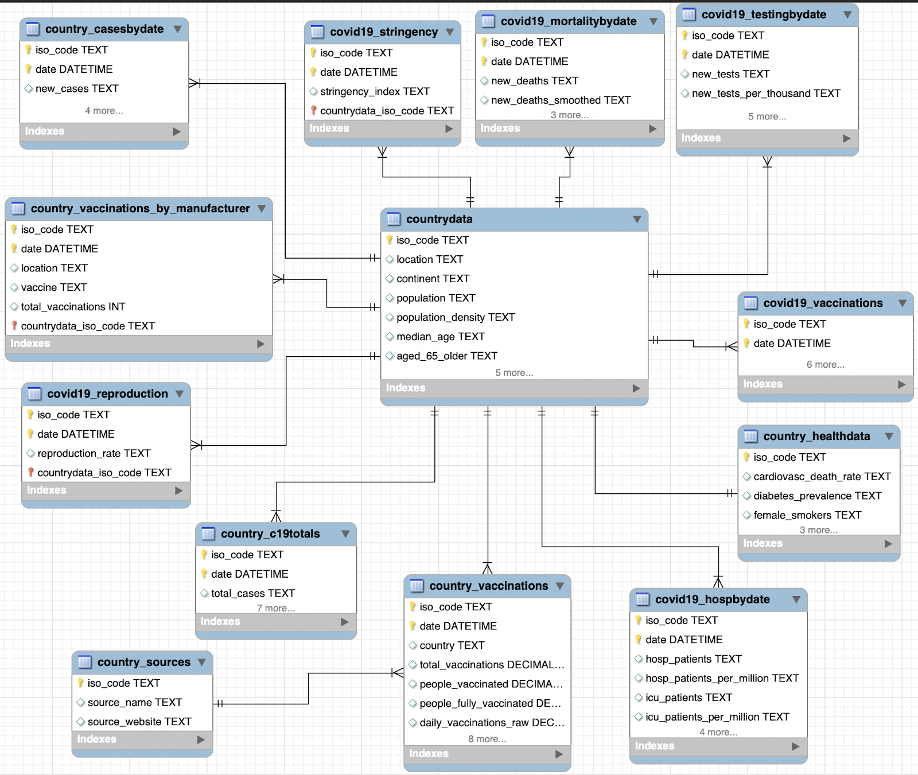
Entity-Relationship Diagram
Introduction
Relational Database Design
Implementation of methods
Comparison of Databases
Recommendations
Conclusion

Slide 14
Creating the Tables in
MySQL
Introduction
Relational Database Design
Implementation of methods
Comparison of Databases
Recommendations
Conclusion
01
02
Made use of CREATE, followed by SELECT statements
Tables with static data required to use DISTINCT
03
04
ALTER was used with DROP to remove source columns
ALTER, followed by ADD COLUMN, UPDATE and INNER JOIN of the 2 tables involved was used to create new column iso_code in country_vaccinations_by_manufacturer

Slide 15
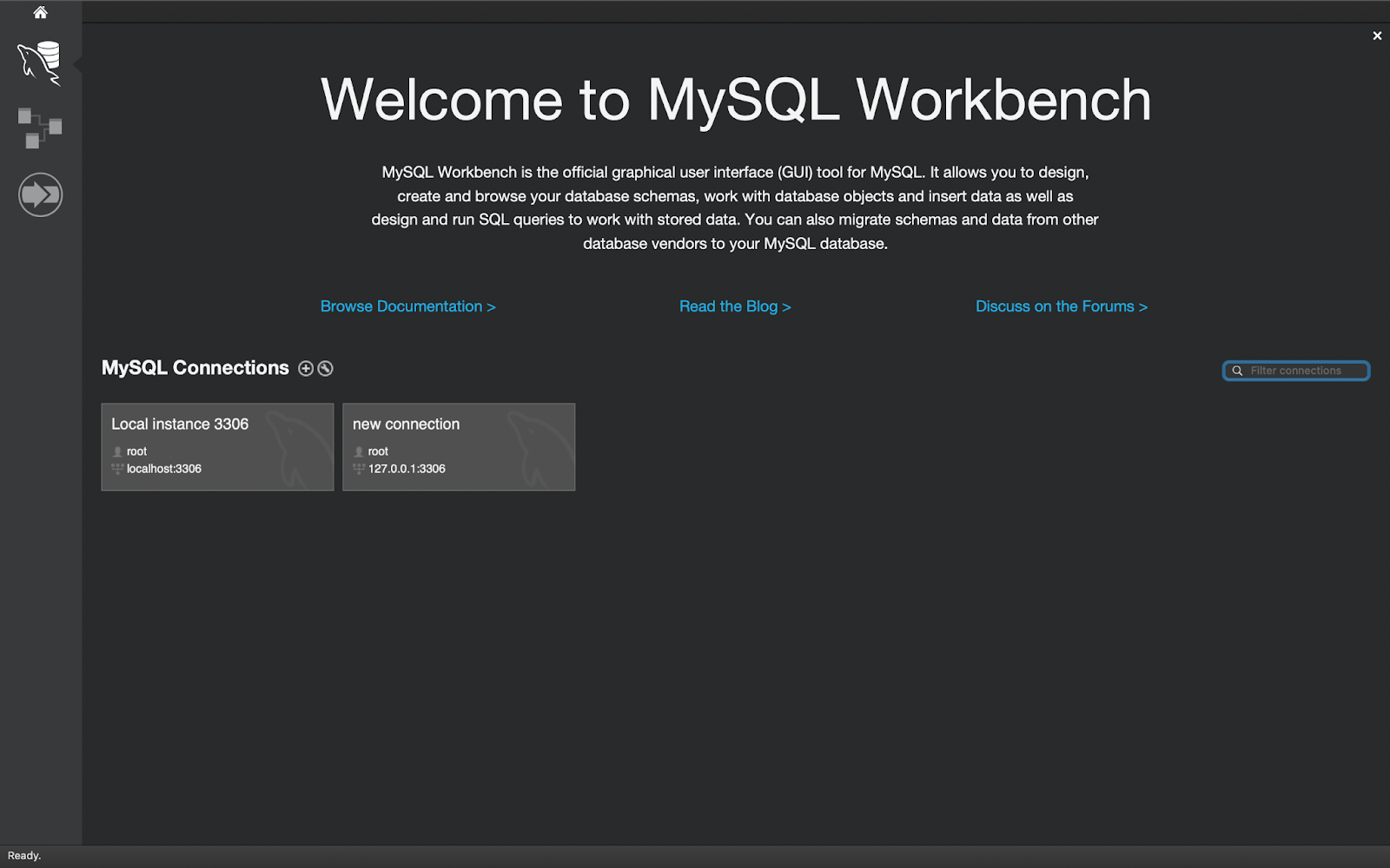
Implementation of MySQL Database (TO SCREEN RECORD)

Slide 16
Relational vs Non-Relational
Querying
Introduction
Relational Database Design
Implementation of methods
Comparison of Databases
Recommendations
Conclusion
VS
SQL
NoSQL

Slide 17
Relationships in queries
for MySQL and MongoDB
Introduction
Relational Database Design
Implementation of methods
Comparison of Databases
Recommendations
Conclusion
Subqueries
.aggregate()
MySQL
NoSQL
Union
Join
$lookup
pipeline
MySQL allows user to link data between two or more tables easily
MongoDB has no support for linking collections directly but there are alternative workarounds

Slide 18

Introduction
Relational Database Design
Implementation of methods
Comparison of Databases
Recommendations
Conclusion
Vaccination Effects. Specific to Germany, on a daily basis, based on the total number of accumulated vaccinations (sum of total_vaccinations of each vaccine in a day), generate the daily new cases after 21 days, 60 days, and 120 days.

Slide 19
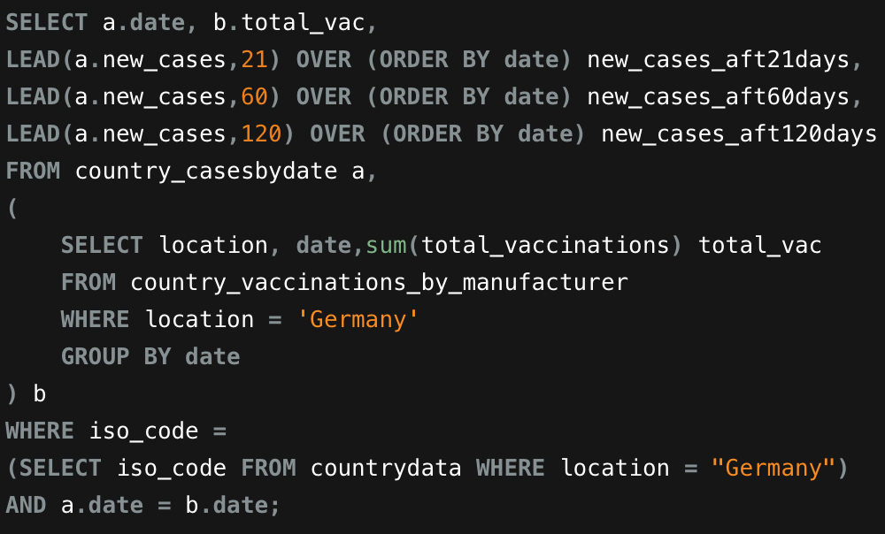
SQL
Introduction
Relational Database Design
Implementation of methods
Comparison of Databases
Recommendations
Conclusion
1
Sub Query b
Sum of total_vaccinations by date in Germany
2
Lead Function
Overall select using lead generating new_cases data after 21 days, 60 days and 21 days
3
2 Tables Used
Subquery b and country_casesbydate
Inner joined based on date
overall query was filtered by iso code for Germany

Slide 20
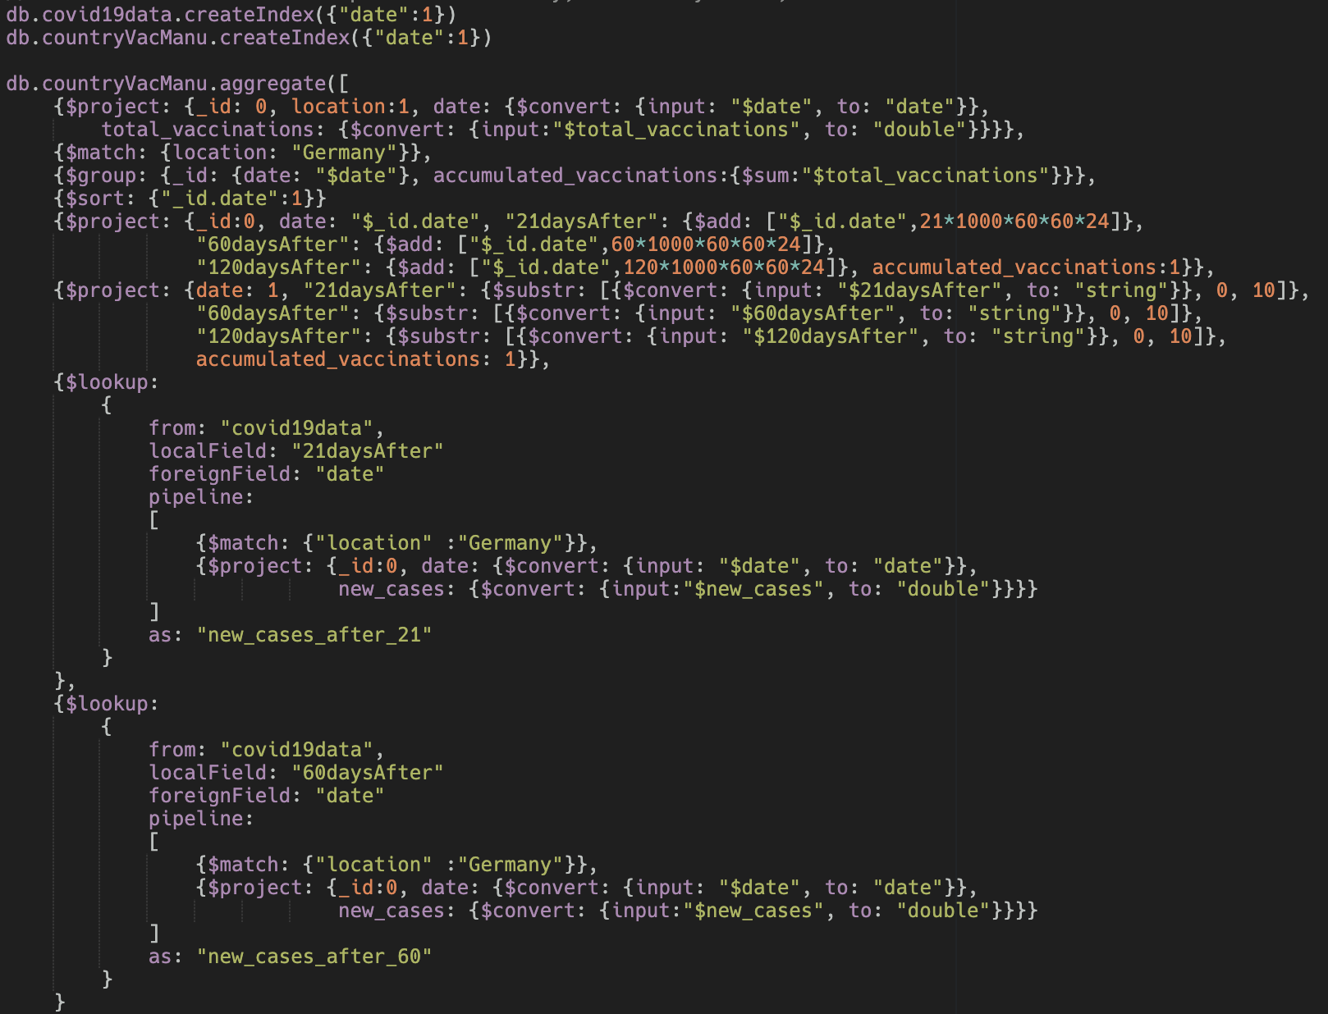
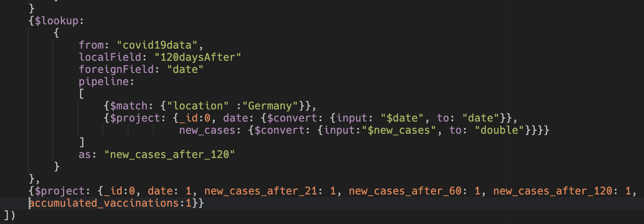
Introduction
Relational Database Design
Implementation of methods
Comparison of Databases
Recommendations
Conclusion

Slide 21
NoSQL
Introduction
Relational Database Design
Implementation of methods
Comparison of Databases
Recommendations
Conclusion
Project
6
Project
1
Location, date, total vaccinations
Date, convert datatype of 21daysAfter, 60daysAfter and 120daysAfter to “string”. Using $substr, obtain the first 10 characters of 21daysAfter, 60daysAfter and 120daysAfter
Match
2
Location to Germany
7
Lookup
3
Group by Date
From covid19data, 3 times
Retrieve to total accumulated vaccinations by finding sum of total vaccinations
Match location to Germany
Project and convert the data type of date and total_vaccinations to “date” and “double”
Sort Date
4
Chronological
8
Project
Project
5
Date, accumulated vaccinations, dates 21, 60 and 120 days after
Project date, accumulated_vaccinations, new_cases_after_21, new_cases_after_60 and new_cases_after_120.

Slide 22
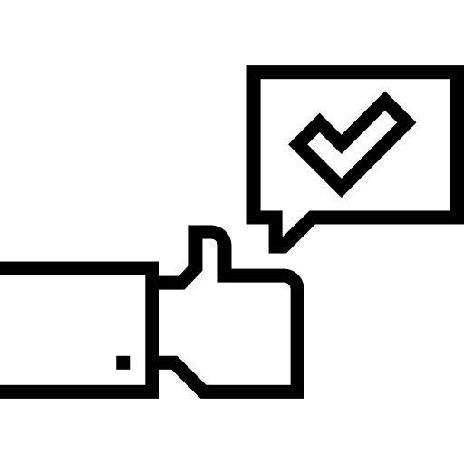
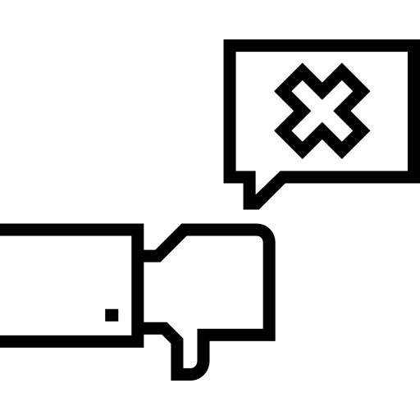
SQL vs NoSQL Analysis
Introduction
Relational Database Design
Implementation of methods
Comparison of Databases
Recommendations
Conclusion
NoSQL
SQL
Pros
Cons
Pros
Cons
Compared to the SQL query addressing the same question, the NoSQL query would be better able to handle changes by data providers
Lengthier query with more operations and thus more room for mistakes
Complexity is higher as a lookup operation needs to be performed multiple times
Significantly shorter query, lesser operations necessary
the lead function assumes that the there will always be 4 rows of data for each date for Germany, based off the 4 vaccines types it has
Overall
One of the most important things about a query is its readability and the NoSQL aggregation step by step flow, while much longer, addresses this much better.

Slide 23
Relational vs Non-Relational
Introduction
Relational Database Design
Implementation of methods
Comparison of Databases
Recommendations
Conclusion
Structure
Has predefined schema. Is table based, with clearly defined rows and columns.
Has dynamic schema for unstructured data. No standard schema definitions to adhere to, very flexible.
Scalability
Horizontally Scalable, can become larger and more powerful. Preferred choice for large or constantly evolving data sets.
Vertically Scalable
Flexibility
Rigid and must be defined before use. Inflexible and modifications are often difficult and labor-intensive.
Less structured and confined. Allows users to continuously add new features and functionality into their systems.

Slide 24
Relational vs Non-Relational
Introduction
Relational Database Design
Implementation of methods
Comparison of Databases
Recommendations
Conclusion
Performance & Speed
Gets slower when database size gets larger. Best used for databases with a smaller volume.
Able to handle large unstructured data faster. Can query in a manner that is capable of handling a greater workload.
CAP Theorem
Consistency and Availability Data presented will be consistent between all working nodes. Allows users to make any read or write request from any node, while ensuring the data is consistent.
Consistency and Partition tolerance A consistent view of the database is available for all users. With Partition tolerance, database is able to continue functioning despite any number of breakdowns between the nodes.

Slide 25




Best Model for WHO
Introduction
Relational Database Design
Implementation of methods
Comparison of Databases
Recommendations
Conclusion
Data Types
Amount of Data
What type of data?
WHO manages and maintains a wide range of data from many different sources. This might result in inconsistent rows and columns for different datasets.
WHO deals with a large volume of data, since information on vaccinations and COVID-19 cases from various countries are updated on a daily basis.
Data Types
4 factors to consider
How much data?
Amount of Data
Capacity
Real-Time Data
Do we need real-time
data?
Dashboards are updated daily, using non-relational databases allows WHO handle a greater workload.
Our team believes that WHO has the capacity and manpower necessary to employ non-relational databases.
Real-Time
Data
Capacity
How much resources do we have?

Slide 26
Limitations
Introduction
Relational Database Design
Implementation of methods
Comparison of Databases
Recommendations
Conclusion
Low
Efficiency
Structural
Inconsistency
Lack of Support
Likely attributed to
inconsistency of non-relational databases
More work must be performed to customize the queries for data retrieval, manipulation and exploration
Limited features which are usually present in relational databases
Inevitable Room for Growth
Despite all this, the non-relational database model is still in its infancy stages and shows great potential.

Slide 27
Future Plans.
To bridge the gaps we’ve identified.
Introduction
Relational Database Design
Implementation of methods
Comparison of Databases
Recommendations
Conclusion

Slide 28
Future Plans
Introduction
Relational Database Design
Implementation of methods
Comparison of Databases
Recommendations
Conclusion
Hybrid Approach
Cloud Computing
Relational Databases
+
Non-relational Databases
Allows us to fully capitalize on both benefits. The capabilities of horizontal scaling are now potentially possible while achieving consistency at the same time.
Efficient &
Flexible
Inexpensive cost of adoption
Robust & Comprehensive

Slide 29

Conclusion.
Thank you!
Introduction
Relational Database Design
Implementation of methods
Comparison of Databases
Recommendations
Conclusion

Slide 30

Thanks!
Does anyone have any questions?
addyouremail@freepik.com
+91 620 421 838
yourcompany.com
Notes:
For credits purposes.

Slide 31
Credits
This is where you give credit to the ones who are part of this project.
Did you like the resources on this template? Get them for free at our other websites.
Presentation template by Slidesgo
Icons by Flaticon
Images & infographics by Freepik
Pictures by Peoplecreations (slides 10, 18 & 21) and Freepik (slides 1, 2, 4, 5, 9, 19, 20, 22, 23, 24, 25, 26 & 31)
Notes:
For credits purposes.

Slide 32

Notes:
For credits purposes.

